Slide 1
Lecture 9 Graph
Ran Cheng (程然)
https://chengran.tech/
https://emi.sustech.edu.cn/

Slide 2
Our Roadmap
Graph Concepts
Graph Traversal
Breath First Search
Depth First Search
Shortest Path Algorithm (SP)
Minimum Spanning Tree (MST)
Strongly Connected Component (SCC)

Slide 3
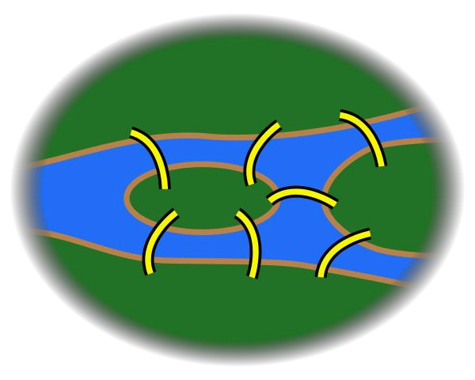
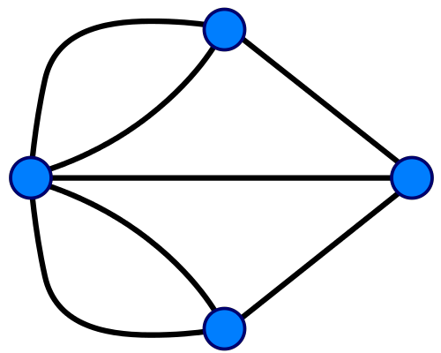

What is a graph (图)
City A was set on both sides of the River, and included two large islands which were connected to each other by seven bridges.
The problem was to devise a path through the city that would cross each of those bridges once and only once. (Seven Bridges of Königsberg, 一笔画问题)

Slide 4
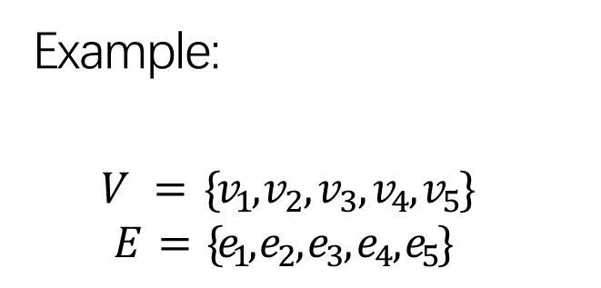
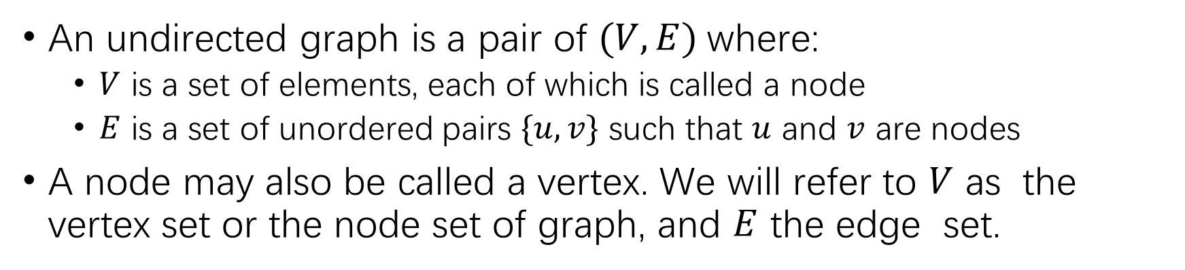
Undirected Graph
An undirected graph is a pair of $(V, E)$where:
$V$ is a set of elements, each of which is called a node
$E$ is a set of unordered pairs $\{u,v\}$ such that $u$ and $v$ are nodes
A node may also be called a vertex. We will refer to $V$ as the vertex set or the node set of graph, and $E$ the edge set.
𝑣₃
Example:
$$V = \{v_{1}, v_{2}, v_{3}, v_{4}, v_{5}\}$$
$$E = \{e_{1}, e_{2}, e_{3}, e_{4}, e_{5}\}$$
𝑒₁
𝑒
2
𝑣
2
𝑣
1
𝑒₃
𝑒₄
𝑒₅
𝑣₄
𝑣₅

Slide 5
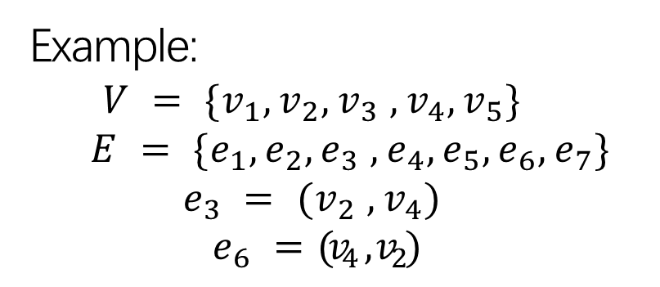
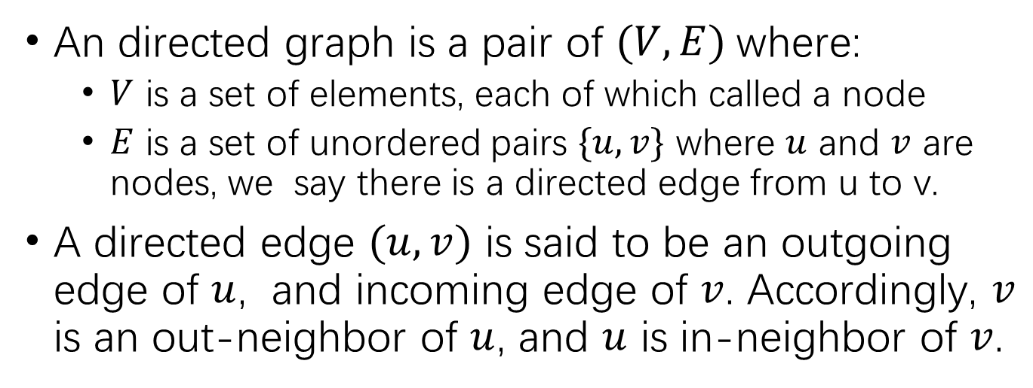
Directed Graph
An directed graph is a pair of $(V, E)$where:
$V$ is a set of elements, each of which called a node
$E$ is a set of unordered pairs $\{u,v\}$ where $u$ and $v$ are nodes, we say there is a directed edge from u to v.
A directed edge $(u,v)$ is said to be an outgoing edge of $u$, and incoming edge of $v$. Accordingly, $v$ is an out-neighbor of $u$, and $u$ is in-neighbor of $v$.
𝑣
3
𝑒₁
𝑒₂
𝑣₂
𝑣₁
𝑒
6
𝑒
4
Example:
$$E = \{e_{1}, e_{2}, e_{3} , e_{4}, e_{5}, e_{6}, e_{7}\}V = \{v_{1}, v_{2}, v_{3} , v_{4}, v_{5}\}$$
$$e_{3} = (v_{2} , v_{4})$$
$$e_{6} = (v_{4} , v_{2})$$
𝑒₅
𝑒₇
𝑣₄
𝑣
5

Slide 6

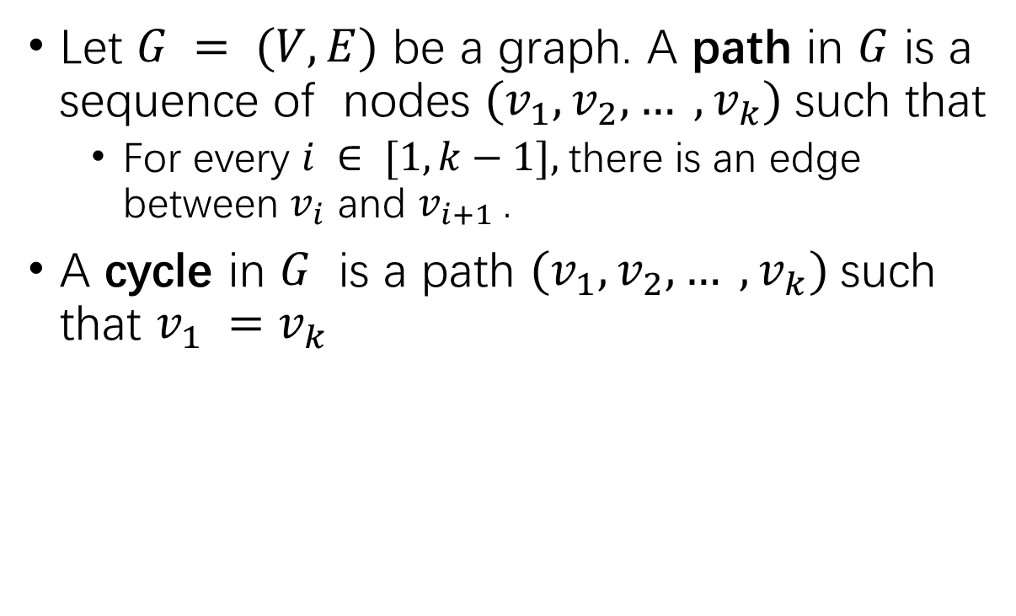
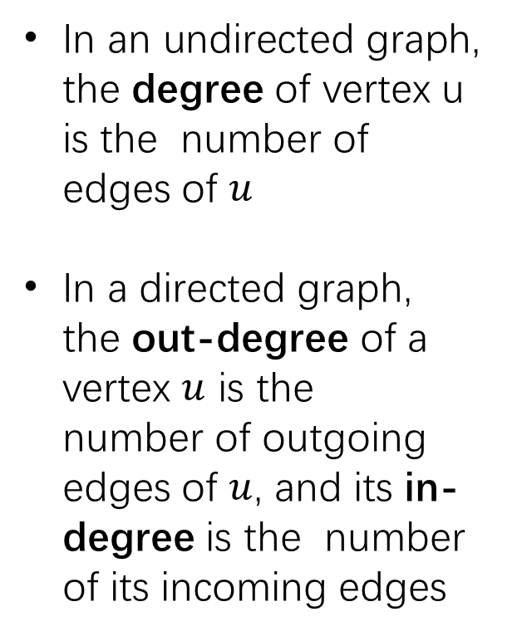
Path, Cycle, Degree
In an undirected graph, the degree of vertex u is the number of edges of $u$
In a directed graph, the out-degree of a vertex $u$ is the number of outgoing edges of $u$, and its in-degree is the number of its incoming edges
Let $G = (V, E)$ be a graph. A path in $G$ is a sequence of nodes $(v_{1}, v_{2}, … , v_{k})$such that
For every $i ∈ [1, k−1],$there is an edge between $v_{i}$ and $v_{i+1}$.
A cycle in $G$ is a path $(v_{1}, v_{2}, … , v_{k})$such that $v_{1} =v_{k}$
Example:
Cycle: $(v1, v2, v4, v1)$; Path: $(v5, v1, v2, v4)$
𝑒₁ 𝑣₃
𝑣₁
𝑒₂
𝑒₄
𝑣₂
𝑒
3
𝑒₅
𝑣₄
𝑣₅

Slide 7
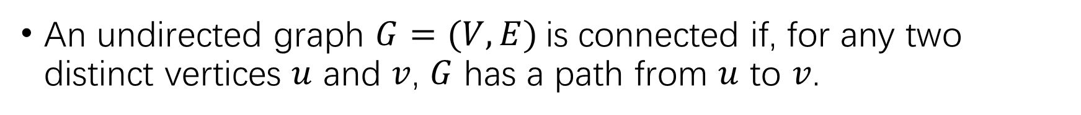
Connected Graph
An undirected graph $G=(V,E)$is connected if, for any two distinct vertices $u$ and $v$, $G$ has a path from $u$ to $v$.
𝑣₃
𝑣₃
𝑒₁
𝑒₁
𝑒₂
𝑒₂
𝑣₂
𝑣₂
𝑣₁
𝑒₃
𝑣₁
𝑒₃
𝑒₄
𝑒₄
𝑒₅
𝑒
5
𝑣₄
𝑣₄
𝑣₅
𝑣₅

Slide 8
Graph vs. Tree vs. Forest
A tree is a connected undirected graph containing no cycles.
Forest is a set of disjoint trees.
𝑣₃ 𝑣₃
𝑣₃
𝑣₂
𝑣₂
𝑣₂
𝑣₁
𝑣₁
𝑣₁
𝑣₆
𝑣₄
𝑣₄
𝑣₄
𝑣₅
𝑣₅
𝑣₅
Graph, not tree
Graph, tree
Graph, forest

Slide 9
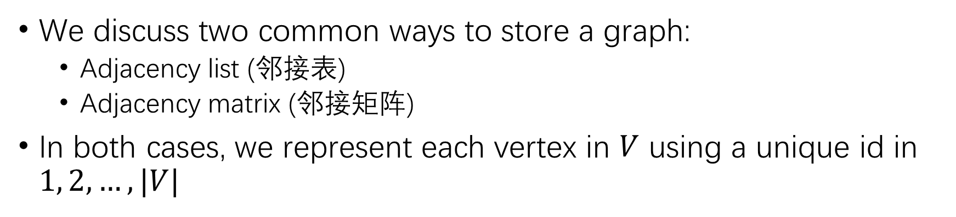
Graph Representation
We discuss two common ways to store a graph:
Adjacency list (邻接表)
Adjacency matrix (邻接矩阵)
In both cases, we represent each vertex in $V$ using a unique id in $1, 2, …, |V|$

Slide 10
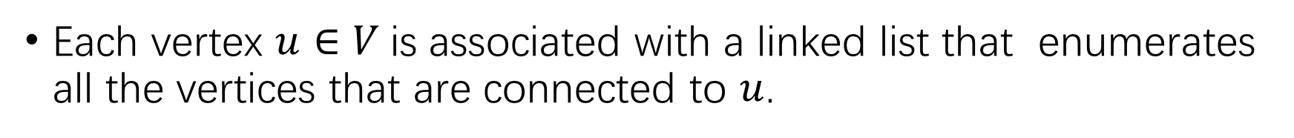

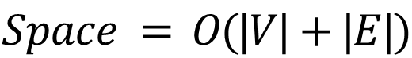
Adjacency List: Undirected $G$
Each vertex $u∈V$is associated with a linked list that enumerates all the vertices that are connected to $u$.
𝑣₃
𝑣₁
𝑣₅
^
𝑣₂
𝑣₃
𝑣₄
𝑣₂
𝑣₂
𝑣₃
𝑣₄
𝑣₅
𝑣₁
𝑣₄
^
𝑣₁
𝑣₁
^
𝑣₄
𝑣₁
𝑣₂
^
𝑣
5
$$Space = O(|V|+|E|)$$
𝑣₁
^

Slide 11
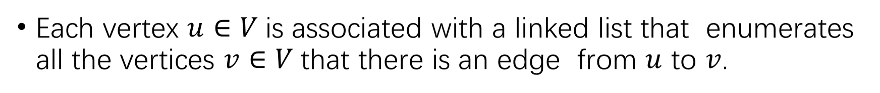

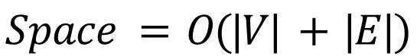
Adjacency List: Directed $G$
Each vertex $u∈V$is associated with a linked list that enumerates all the vertices $v∈V$that there is an edge from $u$ to $v$.
𝑣₁
𝑣₂
𝑣₂
𝑣₃
^
𝑣₃
𝑒₁
𝑒₂
𝑒₄
𝑣₄
^
𝑣₂
𝑣₁
𝑣₃
^
𝑒₆
𝑒
3
𝑒
𝑣
𝑣₁
𝑣₂
^
5
4
𝑒₇
𝑣₄
𝑣
5
𝑣₅
𝑣₁
𝑣₄
^
$$Space = O(|V| + |E|)$$

Slide 12

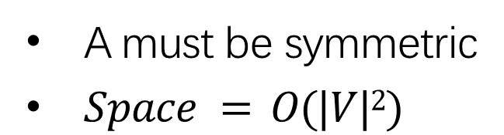
Adjacency Matrix: Undirected $G$
A $|V|∗|V|$matrix $A$ where $A[u,v] = 1$if $(u, v)∈E$, or $0$ otherwise
𝑣₃
𝑣₂
𝑣₁
 | 𝑣₁ | 𝑣₂ | 𝑣₃ | 𝑣₄ | 𝑣₅
𝑣₁ | 0 | 1 | 1 | 1 | 1
𝑣₂ | 1 | 0 | 0 | 1 | 0
𝑣₃ | 1 | 0 | 0 | 0 | 0
𝑣₄ | 1 | 1 | 0 | 0 | 0
𝑣₅ | 1 | 0 | 0 | 0 | 0
A must be symmetric
$Space = O(|V|2)$
𝑣₄
𝑣
5

Slide 13
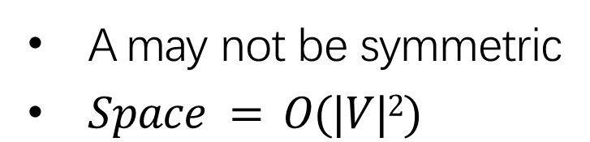

Adjacency Matrix: Directed $G$
Defined in the same way as in the undirected graph
𝑣₃
𝑒₁
 | 𝑣₁ | 𝑣₂ | 𝑣₃ | 𝑣₄ | 𝑣₅
𝑣₁ | 0 | 1 | 1 | 0 | 0
𝑣₂ | 0 | 0 | 0 | 1 | 0
𝑣₃ | 0 | 0 | 0 | 0 | 0
𝑣₄ | 1 | 1 | 0 | 0 | 0
𝑣₅ | 1 | 0 | 0 | 1 | 0
𝑒₂
𝑣₂
𝑣₁
𝑒
𝑒₆
3
𝑒
4
𝑒₅
𝑒₇
𝑣₄
𝑣
5
A may not be symmetric
$Space = O(|V|2)$

Slide 14
Our Roadmap
Graph Concepts
Graph Traversal
Breath First Search
Depth First Search
Shortest Path Algorithm (SP)
Minimum Spanning Tree (MST)
Strongly Connected Component (SCC)

Slide 15
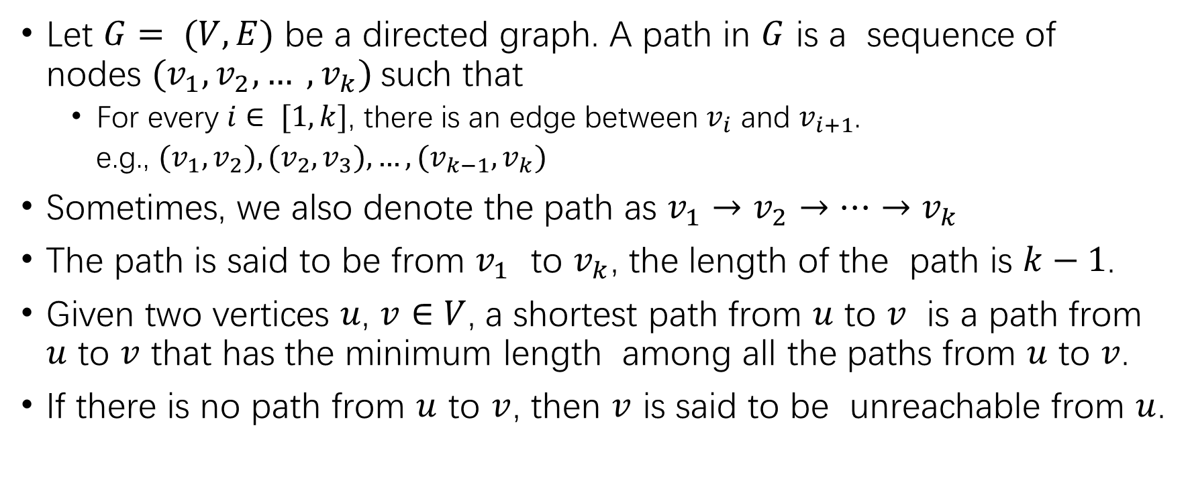
Shortest Path
Let $G= (V, E)$ be a directed graph. A path in $G$ is a sequence of nodes $(v_{1}, v_{2}, … , v_{k})$such that
For every $i∈ [1, k]$, there is an edge between $v_{i}$ and $v_{i+1}$.
e.g., $(v_{1}, v_{2}), (v_{2}, v_{3}), …, (v_{k−1}, v_{k})$
Sometimes, we also denote the path as $v_{1}→v_{2}→⋯→v_{k}$
The path is said to be from $v_{1}$ to $v_{k}$, the length of the path is $k−1$.
Given two vertices $u$, $v∈V$, a shortest path from $u$ to $v$ is a path from $u$ to $v$ that has the minimum length among all the paths from $u$ to $v$.
If there is no path from $u$ to $v$, then $v$ is said to be unreachable from $u$.

Slide 16
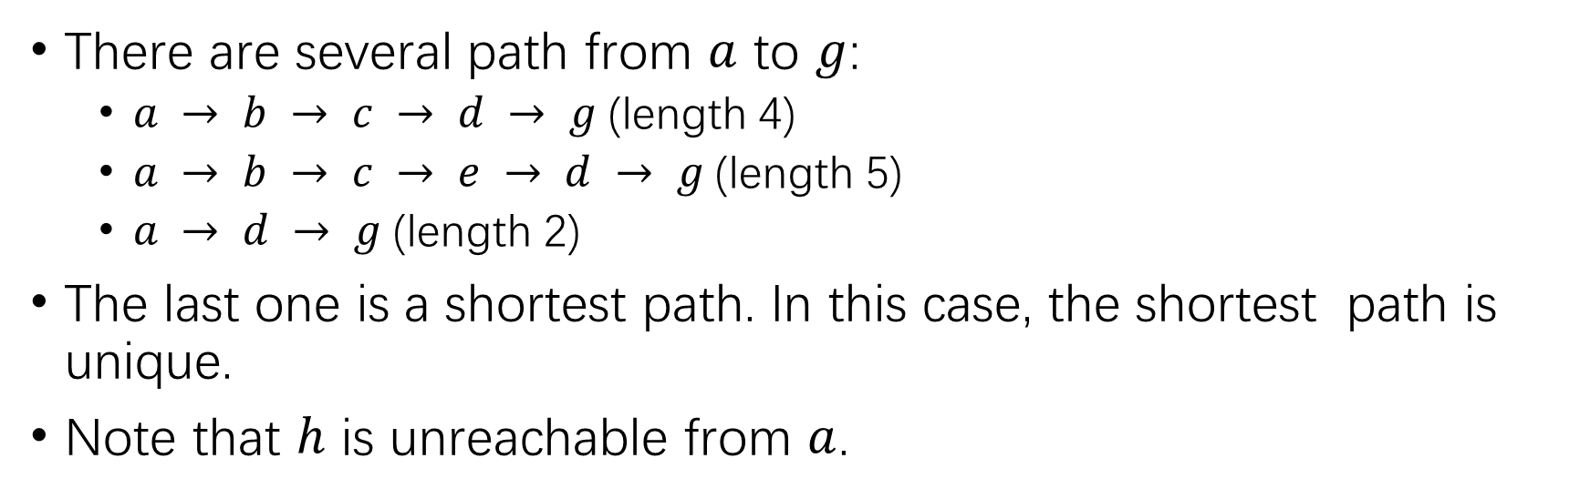
Shortest Path Example
𝑎 ℎ
𝑏
𝑑
𝑔
𝑖
𝑓
𝑐
𝑒
There are several path from $a$ to $g$:
$a → b → c → d → g$(length 4)
$a → b → c → e → d → g$(length 5)
$a → d → g$(length 2)
The last one is a shortest path. In this case, the shortest path is unique.
Note that $h$ is unreachable from $a$.

Slide 17
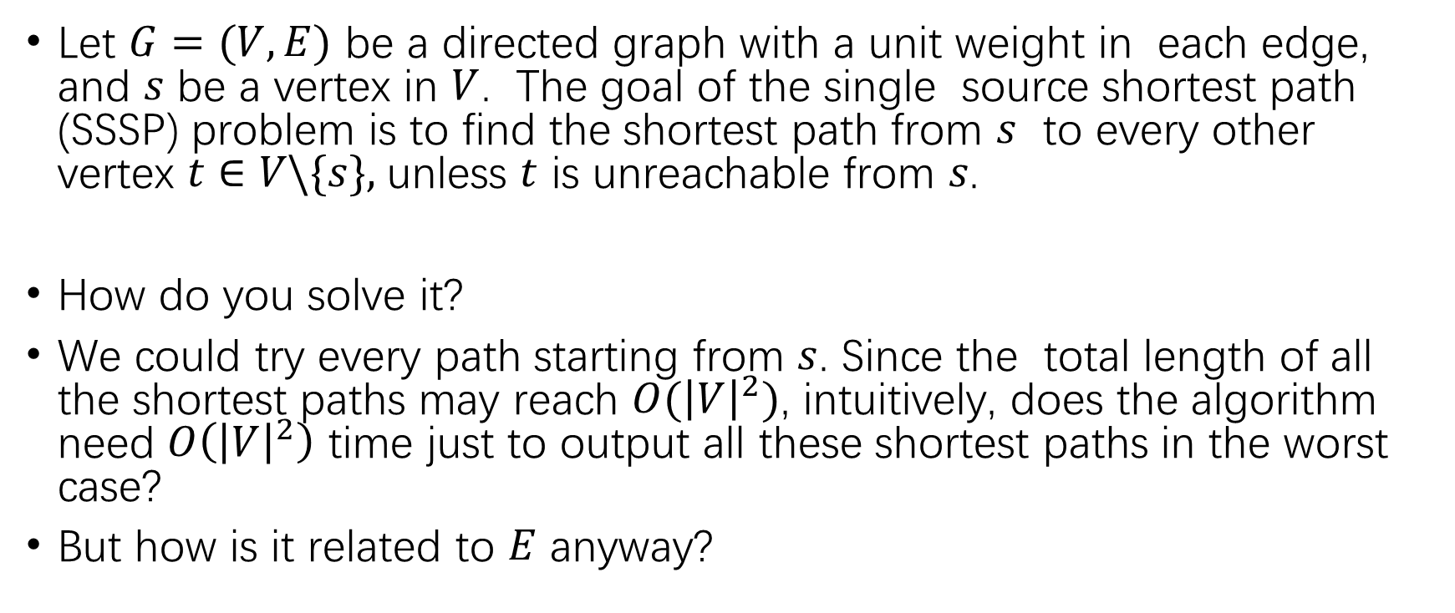
Single Source Shortest Path (SSSP)
Let $G=(V,E)$ be a directed graph with a unit weight in each edge, and $s$ be a vertex in $V$. The goal of the single source shortest path (SSSP) problem is to find the shortest path from $s$ to every other vertex $t∈V\backslash \{s\},$unless $t$ is unreachable from 𝑠.
How do you solve it?
We could try every path starting from $s$. Since the total length of all the shortest paths may reach $O({\left|V\right|}^{2})$, intuitively, does the algorithm need $O\left({\left|V\right|}^{2}\right)$ time just to output all these shortest paths in the worst case?
But how is it related to $E$ anyway?

Slide 18
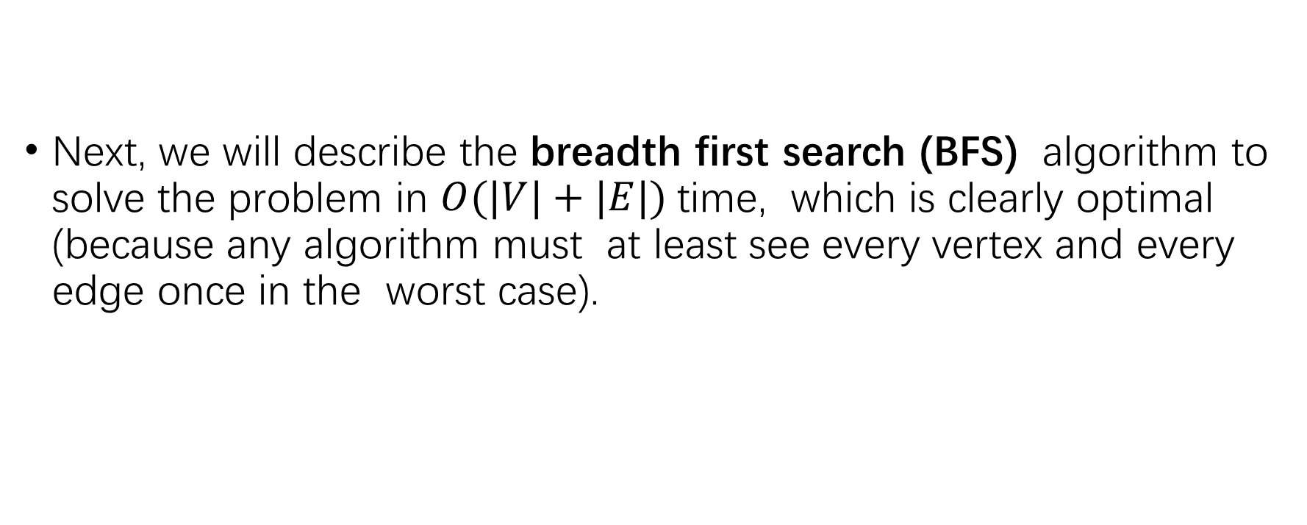
SSSP
Next, we will describe the breadth first search (BFS) algorithm to solve the problem in $O(|V|+|E|)$time, which is clearly optimal (because any algorithm must at least see every vertex and every edge once in the worst case).

Slide 19
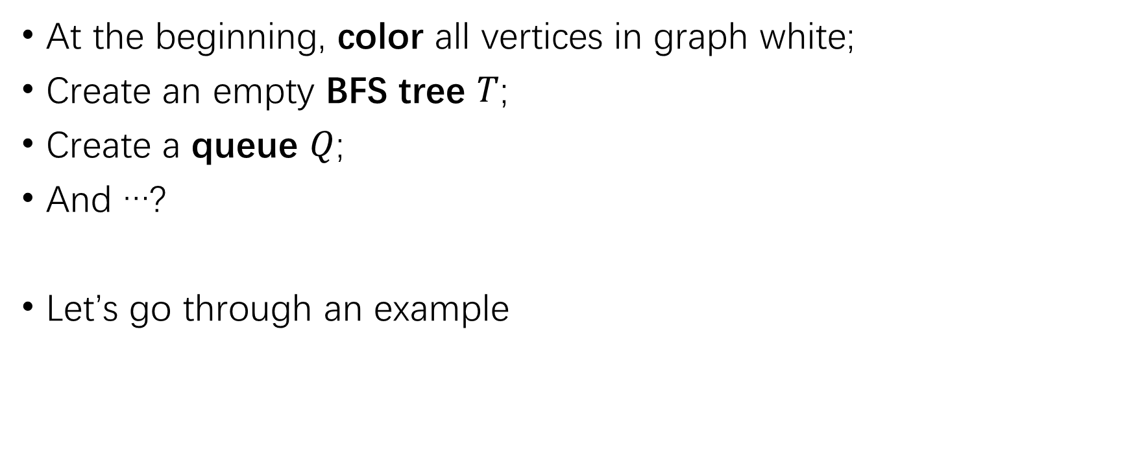
Breadth First Search (BFS)
At the beginning, color all vertices in graph white;
Create an empty BFS tree $T$;
Create a queue $Q$;
And …?
Let’s go through an example

Slide 20
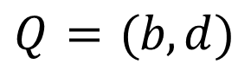
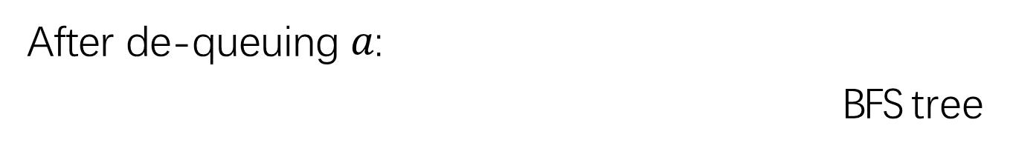
After de-queuing $a$:
BFS tree
𝑎 ℎ
𝑎
𝑏
𝑑
𝑏
𝑑
𝑔
𝑖
𝑓
𝑐
𝑒
$$Q = (b, d)$$

Slide 21
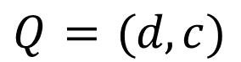
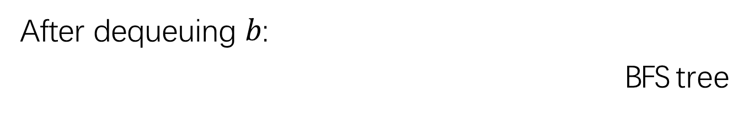
After dequeuing $b$:
BFS tree
𝑎 ℎ
𝑎
𝑏
𝑑
𝑏
𝑑
𝑔
𝑖
𝑓
𝑐
𝑐
𝑒
$$Q = (d, c)$$

Slide 22
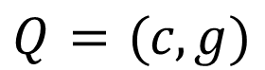
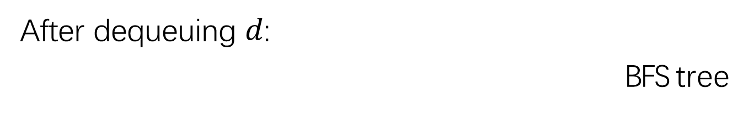
After dequeuing $d$:
BFS tree
𝑎 ℎ
𝑎
𝑏
𝑑
𝑏
𝑑
𝑔
𝑖
𝑓
𝑐
𝑔
𝑐
𝑒
$$Q = (c, g)$$

Slide 23
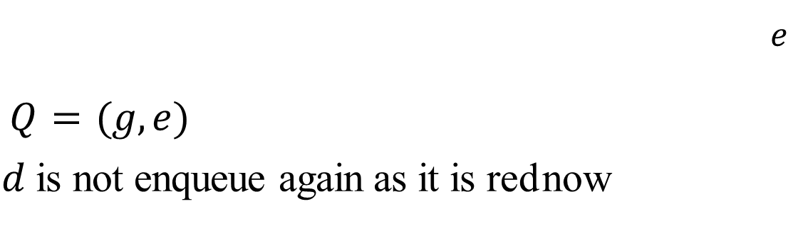
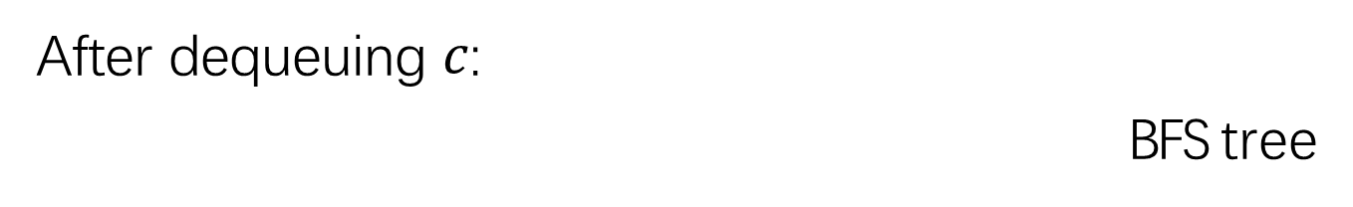
After dequeuing $c$:
BFS tree
𝑎 ℎ
𝑎
𝑏
𝑑
𝑏
𝑑
𝑔
𝑖
𝑓
𝑐
𝑔
𝑐
𝑒
𝑒
$Q = (g, e)$
$d$ is not enqueue again as it is red now

Slide 24
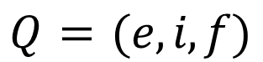
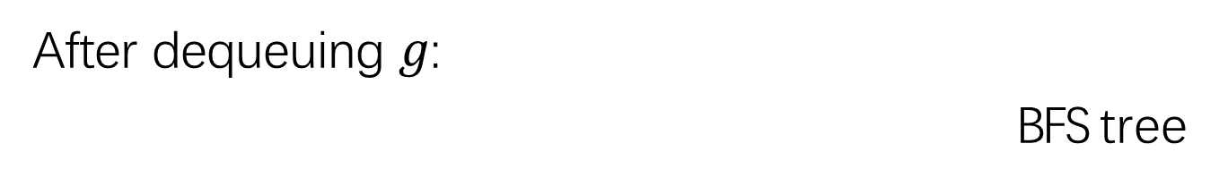
After dequeuing $g$:
BFS tree
𝑎 ℎ
𝑎
𝑏
𝑑
𝑏
𝑑
𝑔
𝑖
𝑓
𝑐
𝑔
𝑐
𝑒
𝑒
𝑖
𝑓
$$Q = (e, i, f)$$

Slide 25
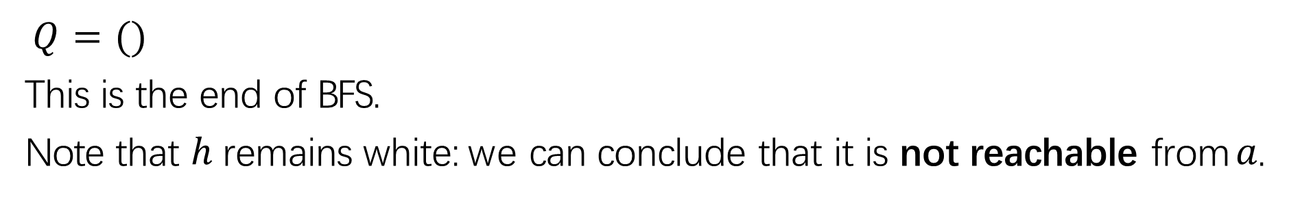
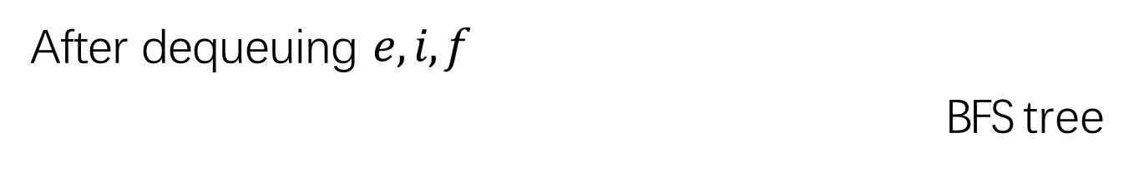
After dequeuing $e, i, f$
BFS tree
𝑎 ℎ
𝑎
𝑏
𝑑
𝑏
𝑑
𝑔
𝑖
𝑓
𝑐
𝑔
𝑐
𝑒
𝑒
𝑖 𝑓
$Q = ()$
This is the end of BFS.
Note that $h$ remains white: we can conclude that it is not reachable from $a$.

Slide 26
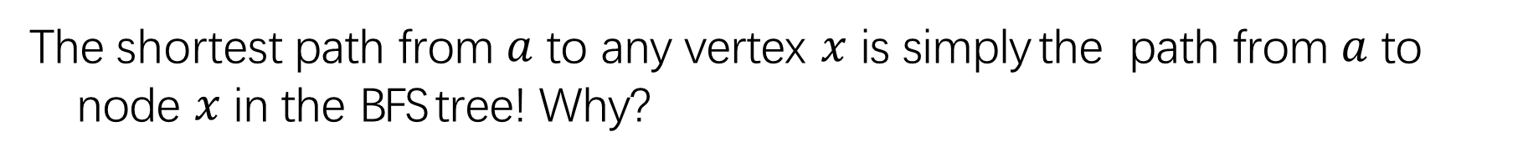
Where are the shortest paths?
BFS tree
𝑎
𝑏 𝑑
𝑐 𝑔
𝑎
ℎ
𝑏
𝑑
𝑔
𝑖
𝑓
𝑐
𝑒
𝑒
𝑖 𝑓
The shortest path from $a$ to any vertex $x$ is simply the path from $a$ to node $x$ in the BFS tree! Why?

Slide 27
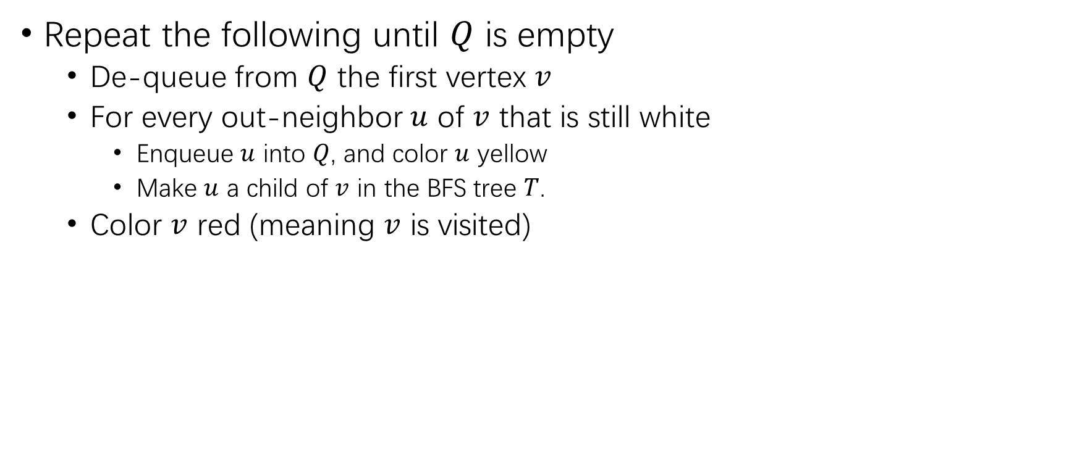
BFS Pseudo Code
Repeat the following until $Q$ is empty
De-queue from $Q$ the first vertex $v$
For every out-neighbor $u$ of $v$ that is still white
Enqueue $u$ into $Q$, and color $u$ yellow
Make $u$ a child of $v$ in the BFS tree $T$.
Color $v$ red (meaning $v$ is visited)

Slide 28
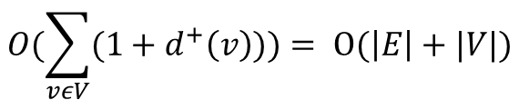
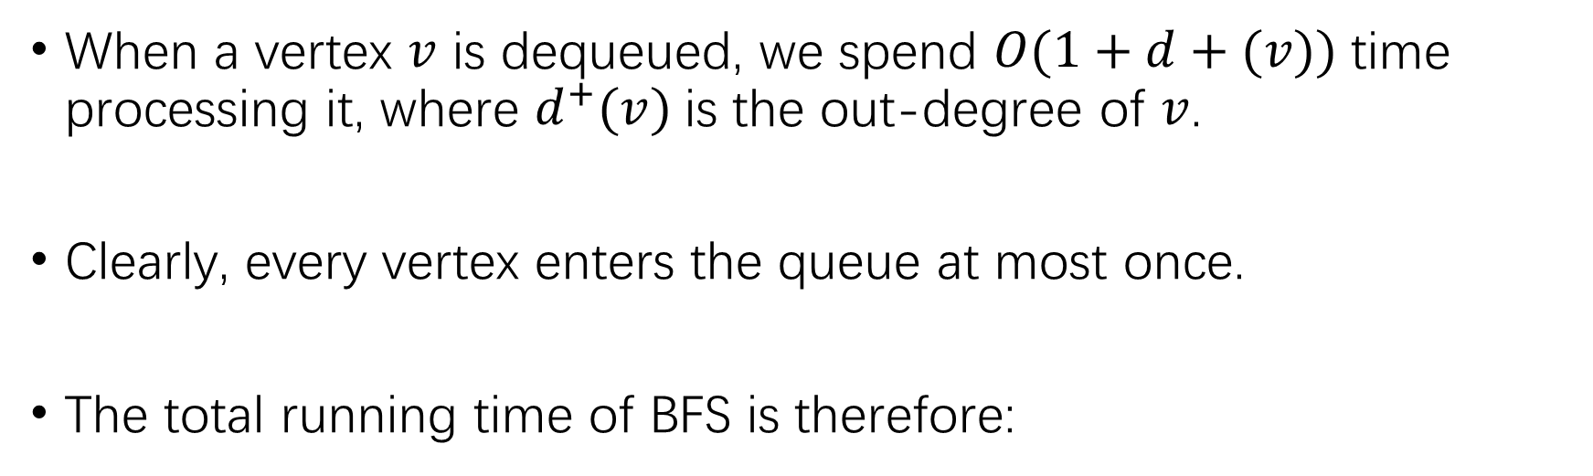
BFS Complexity Analysis
When a vertex $v$ is dequeued, we spend $O(1+d+(v))$time processing it, where $d^{+}(v)$is the out-degree of $v$.
Clearly, every vertex enters the queue at most once.
The total running time of BFS is therefore:
$$O(\sum_{vεV}{(1+d^{+}\left(v\right)))= O(\left|E\right|+|V|)}$$

Slide 29
Our Roadmap
Graph Concepts
Graph Traversal
Breath First Search
Depth First Search
Shortest Path Algorithm (SP)
Minimum Spanning Tree (MST)
Strongly Connected Component (SCC)

Slide 30
Depth First Search (DFS)
We have already learnt breadth first search (BFS).
Today, we will discuss its “sister version”: the depth first search (DFS) algorithm.
Our discussion will once again focus on directed graphs, because the extension to undirected graphs is straight forward.
DFS is a surprisingly powerful algorithm solving several classic problems elegantly. In this lecture, we will see one such problem: detecting whether the input graph contains cycles.

Slide 31
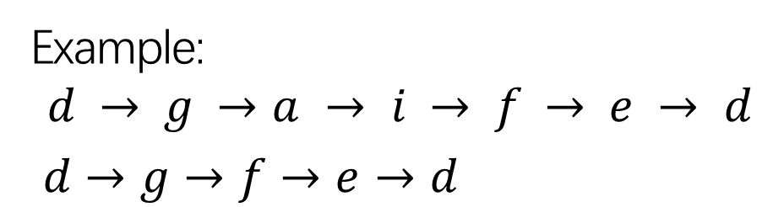
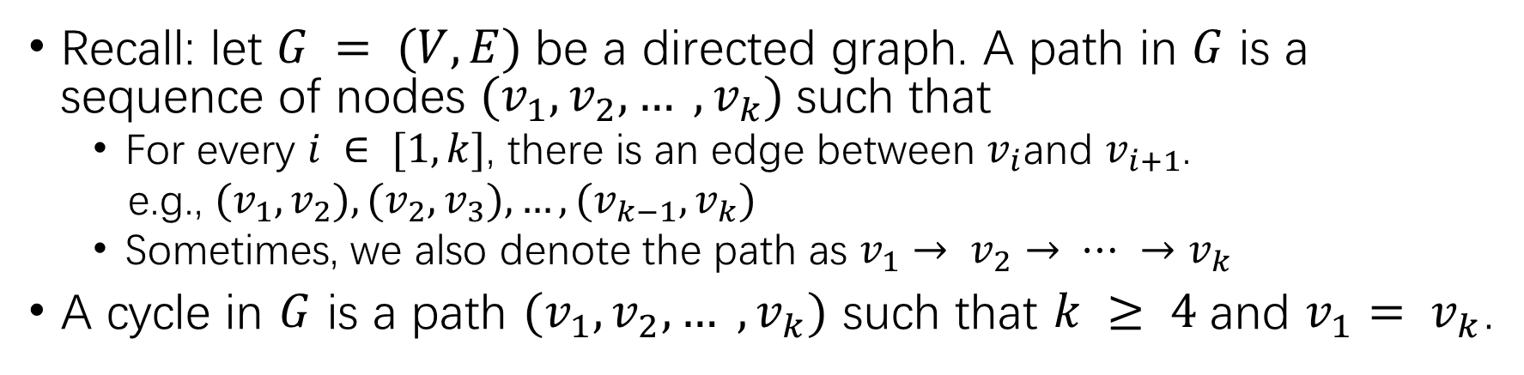
Cycles in a Graph
Recall: let $G = (V, E)$be a directed graph. A path in $G$ is a sequence of nodes $(v_{1}, v_{2}, … , v_{k})$such that
For every $i ∈ [1, k]$, there is an edge between $v_{i}$and $v_{i+1}$.
e.g., $(v_{1}, v_{2}), (v_{2}, v_{3}), …, (v_{k−1}, v_{k})$
Sometimes, we also denote the path as $v_{1}→ v_{2}→ ⋯ →v_{k}$
A cycle in $G$ is a path $(v_{1}, v_{2}, … , v_{k})$ such that $k ≥ 4$and $v_{1}= v_{k}$.
𝑎 ℎ
Example:
$$d → g →a → i → f → e → d$$
$d→g→f→e→d$
𝑏
𝑑
𝑔
𝑖
𝑓
𝑐
𝑒

Slide 32
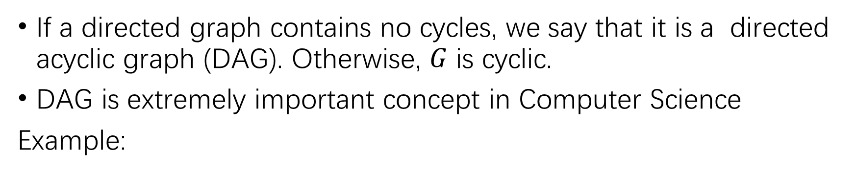
Directed Acyclic Graph (有向无环图)
If a directed graph contains no cycles, we say that it is a directed acyclic graph (DAG). Otherwise, $G$ is cyclic.
DAG is extremely important concept in Computer Science
Example:
𝑎 ℎ
𝑎 ℎ
𝑏
𝑑
𝑔
𝑖
𝑏
𝑑
𝑔
𝑖
𝑓
𝑓
𝑐
𝑒
Cyclic
𝑐
𝑒
DAG

Slide 33
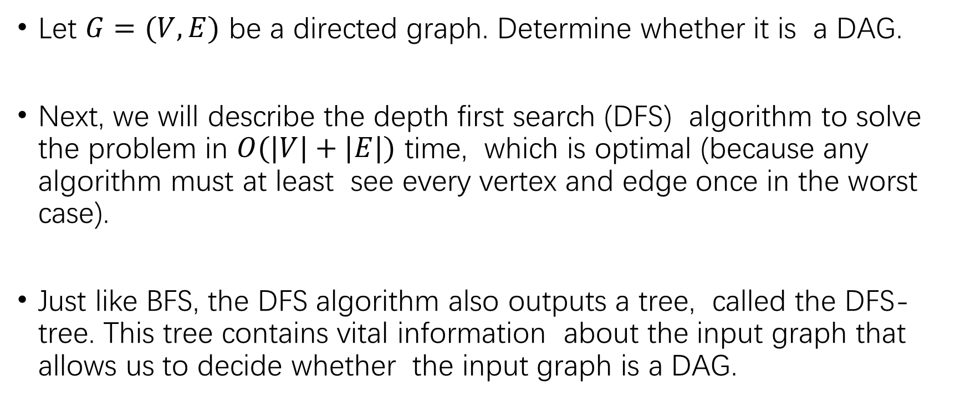
The Cycle Detection Problem
Let $G=(V,E)$ be a directed graph. Determine whether it is a DAG.
Next, we will describe the depth first search (DFS) algorithm to solve the problem in $O(|V|+|E|)$ time, which is optimal (because any algorithm must at least see every vertex and edge once in the worst case).
Just like BFS, the DFS algorithm also outputs a tree, called the DFS-tree. This tree contains vital information about the input graph that allows us to decide whether the input graph is a DAG.

Slide 34
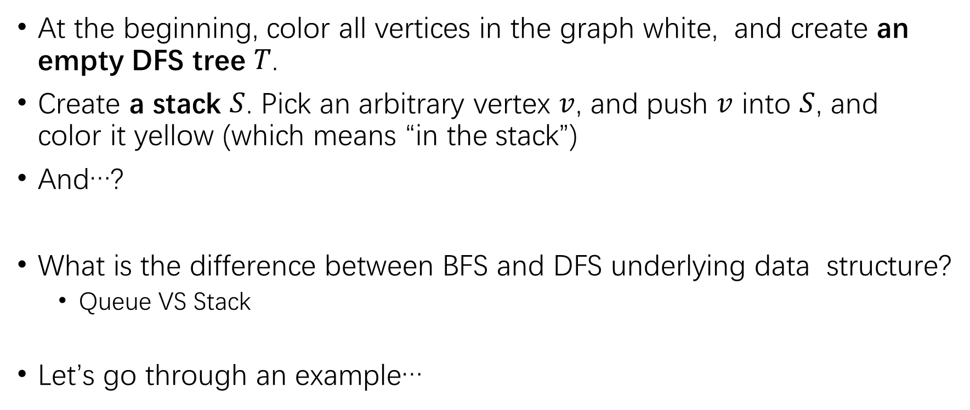
Depth First Search
At the beginning, color all vertices in the graph white, and create an empty DFS tree $T$.
Create a stack $S$. Pick an arbitrary vertex $v$, and push $v$ into $S$, and color it yellow (which means “in the stack”)
And…?
What is the difference between BFS and DFS underlying data structure?
Queue VS Stack
Let’s go through an example…

Slide 35
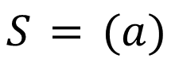

Suppose we start from $a$.
DFS tree
𝑎 ℎ
𝑎
𝑏
𝑑
𝑔
𝑖
𝑓
𝑐
𝑒
$$S = (a)$$

Slide 36
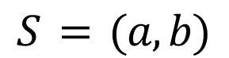
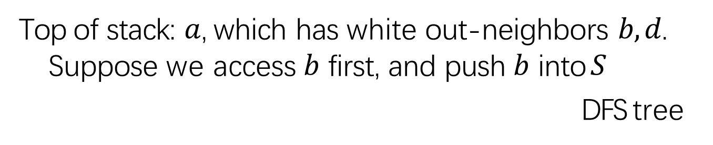
Top of stack: $a$, which has white out-neighbors $b, d$.
Suppose we access $b$ first, and push $b$ into $S$
DFS tree
𝑎 ℎ
𝑎
𝑏
𝑏
𝑑
𝑔
𝑖
𝑓
𝑐
𝑒
$$S = (a, b)$$

Slide 37
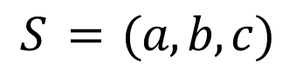
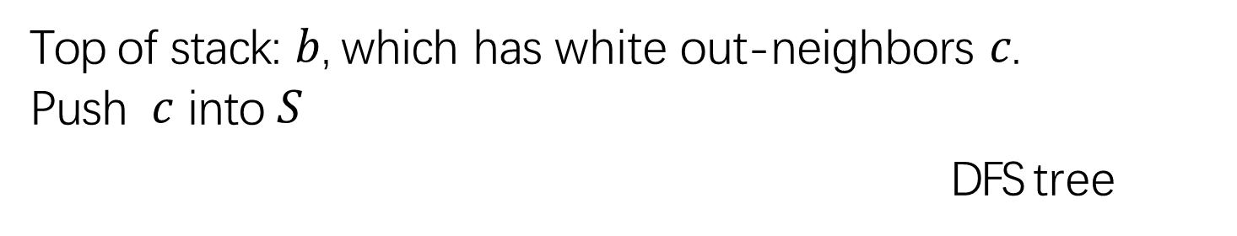
Top of stack: $b$, which has white out-neighbors $c$.
Push $c$ into $S$
DFS tree
𝑎 ℎ
𝑎
𝑏
𝑐
𝑏
𝑑
𝑔
𝑖
𝑓
𝑐
𝑒
$$S = (a, b, c)$$

Slide 38
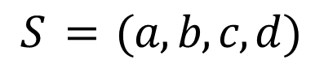
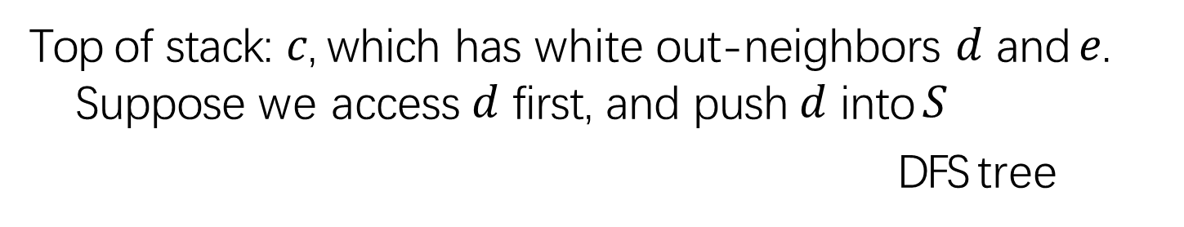
Top of stack: $c$, which has white out-neighbors $d$ and $e$.
Suppose we access $d$ first, and push $d$ into $S$
DFS tree
𝑎 ℎ
𝑎
𝑏
𝑐
𝑑
𝑏
𝑑
𝑔
𝑖
𝑓
𝑐
𝑒
$$S = (a, b, c, d)$$

Slide 39
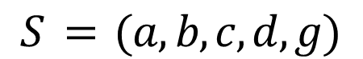

Top of stack: $d$, which has white out-neighbors $g$.
Push $g$ into $S$
DFS tree
𝑎 ℎ
𝑎
𝑏
𝑐
𝑑
𝑔
𝑏
𝑑
𝑔
𝑖
𝑓
𝑐
𝑒
$$S = (a, b, c, d, g)$$

Slide 40


Top of stack: $g$, which has white out-neighbors $f$ and $i$.
Suppose we access $f$ first, and push f into $S$
DFS tree
𝑎 ℎ
𝑎
𝑏
𝑐
𝑑
𝑔
𝑓
𝑏
𝑑
𝑔
𝑖
𝑓
𝑐
𝑒
$$S = (a, b, c, d, g, f)$$

Slide 41


Top of stack: $f$, which has white out-neighbors $e$.
Push $e$ into $S$
DFS tree
𝑎 ℎ
𝑎
𝑏
𝑐
𝑑
𝑔
𝑓
𝑒
𝑏
𝑑
𝑔
𝑖
𝑓
𝑐
𝑒
$$S = (a, b, c, d, g, f, e)$$

Slide 42


Top of stack: $e$ has no white out-neighbors.
So pop it from $S$, and color it red. Similarly for $f$.
DFS tree
𝑎 ℎ
𝑎
𝑏
𝑐
𝑑
𝑔
𝑏
𝑑
𝑔
𝑖
𝑓
𝑐
𝑒
$$S = (a, b, c, d, g)$$
𝑓
𝑒

Slide 43



Top of stack: $g,$ which still has white out-neighbors $i$.
Push $i$ into $S$
DFS tree
𝑎 ℎ
𝑎
𝑏
𝑐
𝑑
𝑔
𝑏
𝑑
𝑔
𝑖
𝑓
𝑐
𝑒
$$S = (a, b, c, d, g, i)$$
𝑓
𝑒
𝑖

Slide 44


After popping $i, g, d, c, b, a$
DFS tree
𝑎 ℎ
𝑎
𝑏
𝑐
𝑑
𝑔
𝑏
𝑑
𝑔
𝑖
𝑓
𝑐
𝑒
$$S = ()$$
𝑓
𝑒
𝑖

Slide 45

Now there is still a white vertex h. So we perform another DFS starting from h
DFS forest
𝑎 ℎ
𝑎
ℎ
𝑏
𝑐
𝑑
𝑔
𝑓
𝑒
𝑏
𝑑
𝑔
𝑖
𝑓
𝑐
𝑒
$$S = (h)$$
𝑖
47

Slide 46


Pop $h$.
The end.
DFS forest
𝑎 ℎ
𝑎
ℎ
𝑏
𝑐
𝑑
𝑔
𝑓
𝑒
𝑏
𝑑
𝑔
𝑖
𝑓
𝑐 𝑒
$S = ( )$
Note that we have created a DFS-forest, Which consists of 2 DFS-trees.
𝑖

Slide 47

DFS Pseudo Code
Repeat the following until $S$ is empty
Let $v$ be the vertex that currently tops the stack $S$ (do not remove $v$ from $S$)
Does $v$ still have a white out-neighbor
If yes: let it be $u$.
Push $u$ into $S$, and color $u$ yellow
Make $u$ a child of $v$ in the DFS-tree $T$
Else: Pop $v$ from $S$, and color $v$ red (meaning $v$ is visited)
If there are still white vertices, repeat the above by restarting from an arbitrary white vertex $v’$, creating a new DFS tree rooted at $v’$.

Slide 48

DFS Complexity Analysis
DFS can be implemented efficiently as follows.
Store $G$ in the adjacency list format
For every vertex $v$, remember the out-neighbor to explore next $O(|V|+|E|)$stack operations
Use an array to remember the colors of all vertices
Hence, the total running time is $O(\left|V\right|+|E|)$.

Slide 49

DFS Tree (Forest)
Recall that we said earlier that the DFS-tree (well, perhaps a DFS forest) encodes information about the input graph. Next, we will make this point specific, and solve the cycle detection problem.
Edge Classification
Suppose we have already built a DFS-forest $T$.
Let $(u,v)$ be an edge in $G$ (remember that the edge is directed from $u$ to $v$). The edge can be classified into:
Forward edge: $u$ is a proper ancestor of $v$ in a DFS-tree of $T$.
Backward edge: $u$ is a descendant of $v$ in a DFS-tree of $T$.
Cross edge: if neither of the above applies.

Slide 50


Edge Classification Example
DFS Forest
𝑎
𝑏
𝑐
𝑑
𝑔
𝑓 𝑖
𝑒
𝑎 ℎ
ℎ
𝑏
𝑑
𝑔
𝑖
𝑓
𝑐
𝑒
Forward edge:
$$\left(a,b\right),(a,d),(b,c),(c,d),(c,e),(d,g),(g,f),(g,i),(f,e)$$
Backward edge: $(e,d)$
Cross edge: $(i,f),(h,d),(h,g)$

Slide 51

Edge Classification Example
How to determine type of each edge $(u,v)$by $O(1)$ cost?
Augmenting DFS slightly!
Maintain a counter $c$, which is initially $0$. Every time a push or pop is performed on the stack, we increment $c$ by $1$.
For every vertex $v$, define:
Its discovery time d-tm($v$) to be the value of $c$ right after $v$ is pushed into the stack
Its finish time f-tm($v$) to be the value of $c$ right after $v$ is popped from the stack
Define $I$($v$) = [d-tm($v$), f-tm($v$)]
It is straight forward to obtain $I$($v$) for all 𝑣 ∈ 𝑉 by paying $O(|V|)$extra time on top of DFS’s running time.

Slide 52

Augment DFS algorithm
DFS Forest
𝑎
𝑏
𝑐
𝑑
𝑔
𝑓 𝑖
𝑒
𝑎 ℎ
ℎ
𝑏
𝑑
𝑔
𝑖
𝑓
𝑐
𝑒
$I\left(a\right)=\left[1, 16\right], I\left(b\right)=\left[2, 15\right], I\left(c\right)=\left[3, 14\right]$
$I(d)=[4, 13], I(g)=[5, 12], I(f)=[6, 9]$
$I\left(e\right)=\left[7, 8\right], I\left(i\right)=\left[10, 11\right], I(h)=[17, 18]$

Slide 53

Theorems
Parenthesis Theorem: all the following are true:
If $u$ is a proper ancestor of $v$ in DFS-tree of $T$, then $I(u)$contains $I(v)$.
If $u$is a proper descendant of $v$ in DFS-tree of $T$, then $I(u)$ is contained in $I(v)$.
Otherwise, $I(u)$ and $I(v)$ are disjoint.
Proof?
Cycle Theorem: let $T$ be an arbitrary DFS-forest. $G$ contains a cycle if and only if there is any backward edge with respect to $T$.

Slide 54

Hint of Cycle Theorem Proof
“if” direction, $(e,d)$ is backward edge.
“only-if” direction:
White Path Theorem: let $u$ be a vertex in $G$. Consider the moment when $u$ is pushed into the stack in the DFS algorithm. Then a vertex $v$ becomes a proper descendant of $u$ in the DFS-forest if and only if the following is true:
We can go from $u$ to $v$ by travelling only on white vertices
We will now prove that if $G$ has a cycle, then there must be a backward edge in the DFS-forest.
Suppose the cycle is $v_{1}→v_{2}→⋯→v_{k}→v_{1}$, and let $v_{i}$ be the first to enter the stack. Then, by white path theorem, all the other vertices in the cycle must be proper descendants of $v_{i}$ in the DFS-forest. This means the edge pointing to $v_{i}$ in the cycle is a backward edge.

Slide 55

Cycle Detection
Equipped with the cycle theorem, we know that we can detect whether $G$ has a cycle easily after having obtained a DFS-forest $T$:
For every edge $(u,v)$, determine whether it is a backward edge in $O(1)$time.
If no backward edges are found, $G$ is a DAG; otherwise, $G$ is a cycle.
Only $O(|E|)$extra time is needed
We now conclude that the cycle detection problem can be solved in $O(|V|+|E|)$time.

Slide 56
Our Roadmap
Graph Concepts
Graph Traversal
Breath First Search
Depth First Search
DGA
Topological Sort
Shortest Path Algorithm (SP)
Minimum Spanning Tree (MST)
Strongly Connected Component (SCC)

Slide 57
Topological Sort on a DAG
As mentioned earlier, depth first search (DFS) algorithm is surprisingly powerful. Indeed, we have already used it to detect efficiently whether a directed graph contains any cycle.
We will use it to tackle another classic problem: topological sort, in linear time.
This algorithm is elegant, and simple enough.

Slide 58


Topological Order
Let $G=(V,E)$be a directed acyclic graph (DAG).
A topological order of $G$ is an ordering of the vertices in $V$ such that, for any edge $(u,v)$, it must hold that $u$ precedes $v$ in the ordering.
Example: two possible topological orders:
$h, a, b, c, d, g, i, f, e$
$a, h, b, c, d, g, i, f, e$
𝑎 ℎ
𝑏
𝑑
𝑔
𝑖
$a, h, d, b, c, g, i, f, e$is not topological order, because of edge $(c,d)$.
𝑓
𝑐
𝑒

Slide 59

The Topological Sort Problem
Let $G=(V,E)$ be a directed acyclic graph (DAG). The goal of topological sort is to produce a topological order of $G$.
Topological Sort Algorithm
Create an empty list $L$
Run DFS on $G$, whenever a vertex $v$ turns red (i.e., it is popped from the stack), append it to $L$
Output the reverse order of $L$
The total running time is clearly $O(|V|+|E|)$

Slide 60

The Topological Sort Example
𝑎 ℎ
𝑏
𝑑
𝑔
𝑖
𝑓
𝑐
𝑒
Suppose we run DFS starting from $a$. The following is one possible order by which the vertices turn red:
$e, f, i, g, d, c, b, a, h$
Therefore, we output $h, a, b, c, d, g, i, f, e$as a topological order.

Slide 61

The Topological Sort Example
𝑎 ℎ
𝑏
𝑑
𝑔
𝑖
𝑓
𝑐
𝑒
Suppose we run DFS starting from $d$, then restarting from $h$, then from $a$. The following is one possible order by which the vertices turn red:
$e, f, i, g, d, h, c, b, a$
Therefore, we output $a, b, c, h, d, g, i, f, e$as a topological order.

Slide 62

Hint: Correctness Analysis
How to prove that the algorithm is correct?
Proof. Take any edge $(u,v)$. We will show that $u$ turns red after $v$, which will complete the proof.
Consider the moment when $u$ enters the stack, we argue that that currently $v$ cannot be in the stack.
Suppose that $v$ were in the stack. As there must be a path chaining up all the vertices in the stack bottom up, we know that there is a path from $v$ to $u$; then, adding the edge $(u,v)$ forms a cycle, thus contradicting the fact that $G$ is a DAG.
$v$ is red: then obviously $u$ will turn red after $v$.
$v$ is white: then by the white path theorem of DFS, we know that $v$ will become a proper descendant of $u$ in the DFS-forest. Therefore, $u$ will turn red after $v$.
Every DAG has a topological order!

Slide 63
Our Roadmap
Graph Concepts
Graph Traversal
Breath First Search
Depth First Search
DGA
Topological Sort
Shortest Path Algorithm (SP)
Minimum Spanning Tree (MST)
Strongly Connected Component (SCC)

Slide 64

Shortest Path
Single source shortest path (SSSP)
All the edges have the same weight, i.e., non-weighted graph
SSSP with arbitrary positive path (SP)
Weighted graph
Let $G=(V,E)$be a directed graph. Let $w$ be a function that maps each edge in $E$ to a positive integer value. Specifically, for each $e∈E$, $w(e)$ is a positive integer value, which we call the weight of $e$.
A directed weighted graph is defined as the pair $(G,w)$.

Slide 65

Weighted Graph
𝑎
ℎ
1
1
6
3
1
1
𝑏
𝑑
𝑔
𝑖
1
2
2
5
𝑓
2
𝑐
𝑒
1
10
The integer on each edge indicates its weight. For example, $w(d,g)=1$, $w(g,f)=2$, and $w(c,e)=10$.

Slide 66

Shortest Path
Consider a directed weighted graph defined by $G=(V,E)$and function $w$.
Consider a path in $G: (v1, v2), (v2, v3), …, (vl , v_{l+1})$, for integer 𝑙$. ≥1$.
We define the length of the path as:
$\sum_{i=1}^{l}{w(}{(v}_{i},v_{i+1}))$
Recall that we may also denote the path as: $v1 → v2 → ⋯ →v_{l+1}$.
Give two vertices $u$, $v∈ V$, the shortest path from $u$ to $v$ is a path from $u$ to $v$ that has the minimum length among all the paths from $u$ to $v$.
If $v$ is unreachable from $u$, then the distance from $u$ to $v$ is $∞$.

Slide 67

SSSP with Positive Weights
Let $(G,w)$ with $G=(V, E)$be a directed weighted graph, where $w$ maps every edge of $E$ to a positive value.
Given a vertex $s$ in $V$, the goal of the SSSP problem is to find, for every other vertex $t∈V\backslash \{s\}$, a shortest path from $s$ to $t$, unless $t$ is unreachable from $s$.
A subsequence property
Lemma: if $v_{1}→v_{2}→⋯→ v_{l+1}$is a shortest path from $v_{1}$ to $v_{l+1}$, then for every $i, j$ satisfying $1≤i≤j≤l+1$, $v_{i}{→v}_{i+1}→⋯→v_{j}$is shortest path from $v_{i}$ to $v_{j}$.
Proof: suppose that this is not true, then we can find a shorter path from $v_{i}$ to $v_{j}$. Using that path to replace the original path from $v_{i}$ to $v_{j}$, the whole path $v_{1}$ to $v_{l+1}$ will become shorter, which contradicts the fact that $v_{1}→v_{2}→⋯→v_{l+1}$ is the shortest path.

Slide 68

Shortest Path Example
The path 𝑐 → 𝑒 has length 10
The path 𝑐 → 𝑑 → 𝑔 → 𝑓 → 𝑒 has length 6
The second path is the shortest path from $c$ to $e$
We know that any subsequence of this path is also a shortest path. For example, 𝑐 → 𝑑 → 𝑔 → 𝑓 must be a shortest path from 𝑐 to 𝑓
𝑎
ℎ
1
1
6
3
1
1
𝑏
𝑑
𝑔
𝑖
1
2
2
5
𝑓
2
𝑐 𝑒
1
10

Slide 69

Dijkstra’s Algorithm
We will first introduce the Dijkstra’s algorithm for solving the SSSP with positive weights problem
Utilizing the subsequence property, our algorithm will create a shortest path tree that encodes all the shortest paths from the source vertex $s$.

Slide 70

Dijkstra’s Algorithm
The edge relaxation idea
For every vertex $v∈V$, we will maintain a value $dist(v)$that represents the length of the shortest path from $s$ to $v$ found so far.
At the end of the algorithm, we will ensure that every $dist(v)$is equal to the precise shortest path from $s$ to $v$
A core operation in our algorithm is called edge relaxation. Given an edge $(u,v)$, we relax it as follows:
If $dist(v) <dist(u) +w(u,v)$, do nothing
Otherwise, reduce $dist(v)$ to $dist(u)+w(u,v)$

Slide 71


Dijkstra’s Algorithm Example
Suppose that the source is $c$
Vertex v | dist(v) | parent(v)
a | ∞ | nil
b | ∞ | nil
c | 0 | nil
d | ∞ | nil
e | ∞ | nil
f | ∞ | nil
g | ∞ | nil
h | ∞ | nil
i | ∞ | nil
𝑎
ℎ
1
1
6
3
1
1
𝑏
𝑑
𝑔
𝑖
1
2
2
5
𝑓
2
𝑐
𝑒
1
10
$$S=\{a,b,c,d,e,f,g,h,i\}$$

Slide 72


Dijkstra’s Algorithm Example
Relax the out-going edge of $c$ (why is $c$?)
Vertex v | dist(v) | parent(v)
a | ∞ | nil
b | ∞ | nil
c | 0 | nil
d | 2 | c
e | 10 | c
f | ∞ | nil
g | ∞ | nil
h | ∞ | nil
i | ∞ | nil
𝑎
ℎ
1
1
6
3
1
1
𝑏
𝑑
𝑔
𝑖
1
2
2
5
𝑓
2
𝑐
𝑒
1
10
$$S=\{a,b,d,e,f,g,h,i\}$$
Note that $c$ has been removed!

Slide 73


Dijkstra’s Algorithm Example
Relax the out-going edge of $d$
Vertex v | dist(v) | parent(v)
a | 8 | d
b | ∞ | nil
c | 0 | nil
d | 2 | c
e | 10 | c
f | ∞ | nil
g | 3 | d
h | ∞ | nil
i | ∞ | nil
𝑎
ℎ
1
1
6
3
1
1
𝑏
𝑑
𝑔
𝑖
1
2
2
5
𝑓
2
𝑐
𝑒
1
10
$$S=\{a,b,e,f,g,h,i\}$$
Note that d has been removed！

Slide 74



Dijkstra’s Algorithm Example
Relax the out-going edge of $g$
Vertex v | dist(v) | parent(v)
a | 8 | d
b | ∞ | nil
c | 0 | nil
d | 2 | c
e | 10 | c
f | 5 | g
g | 3 | d
h | ∞ | nil
i | 4 | g
𝑎
ℎ
1
1
6
3
1
1
𝑏
𝑑
𝑔
𝑖
1
2
2
5
𝑓
2
𝑐
𝑒
1
10
$$S=\{a,b,e,f,h,i\}$$
Note that $g$ has been removed!

Slide 75



Dijkstra’s Algorithm Example
Relax the out-going edge of $i$
Vertex v | dist(v) | parent(v)
a | 8 | d
b | ∞ | nil
c | 0 | nil
d | 2 | c
e | 10 | c
f | 5 | g
g | 3 | d
h | ∞ | nil
i | 4 | g
𝑎
ℎ
1
1
6
3
1
1
𝑏
𝑑
𝑔
𝑖
1
2
2
5
𝑓
2
𝑐
𝑒
1
10
$$S=\{a,b,e,f,h\}$$
Note that $i$ has been removed!
76

Slide 76



Dijkstra’s Algorithm Example
Relax the out-going edge of $f$
Vertex v | dist(v) | parent(v)
a | 8 | d
b | ∞ | nil
c | 0 | nil
d | 2 | c
e | 6 | f
f | 5 | g
g | 3 | d
h | ∞ | nil
i | 4 | g
𝑎
ℎ
1
1
6
3
1
1
𝑏
𝑑
𝑔
𝑖
1
2
2
5
𝑓
2
𝑐
𝑒
1
10
$$S=\{a,b,e,h\}$$
Note that $f$ has been removed!
77

Slide 77


Dijkstra’s Algorithm Example
Relax the out-going edge of $e$
Vertex v | dist(v) | parent(v)
a | 8 | d
b | ∞ | nil
c | 0 | nil
d | 2 | c
e | 6 | f
f | 5 | g
g | 3 | d
h | ∞ | nil
i | 4 | g
𝑎
ℎ
1
1
6
3
1
1
𝑏
𝑑
𝑔
𝑖
1
2
2
5
𝑓
2
𝑐
𝑒
1
10
$$S=\{a,b,h\}$$
Note that e has been removed!

Slide 78


Dijkstra’s Algorithm Example
Relax the out-going edge of $a$
Vertex v | dist(v) | parent(v)
a | 8 | d
b | 9 | a
c | 0 | nil
d | 2 | c
e | 6 | f
f | 5 | g
g | 3 | d
h | ∞ | nil
i | 4 | g
𝑎
ℎ
1
1
6
3
1
1
𝑏
𝑑
𝑔
𝑖
1
2
2
5
𝑓
2
𝑐
𝑒
1
10
$$S=\{b,h\}$$
Note that a has been removed!

Slide 79


Dijkstra’s Algorithm Example
Relax the out-going edge of $b$
Vertex v | dist(v) | parent(v)
a | 8 | d
b | 9 | a
c | 0 | nil
d | 2 | c
e | 6 | f
f | 5 | g
g | 3 | d
h | ∞ | nil
i | 4 | g
𝑎
ℎ
1
1
6
3
1
1
𝑏
𝑑
𝑔
𝑖
1
2
2
5
𝑓
2
𝑐
𝑒
1
10
$$S=\{h\}$$
Note that b has been removed!

Slide 80


Dijkstra’s Algorithm Example
Relax the out-going edge of $h$
Vertex v | dist(v) | parent(v)
a | 8 | d
b | 9 | a
c | 0 | nil
d | 2 | c
e | 6 | f
f | 5 | g
g | 3 | d
h | ∞ | nil
i | 4 | g
𝑎
ℎ
1
1
6
3
1
1
𝑏
𝑑
𝑔
𝑖
1
2
2
5
𝑓
2
𝑐
𝑒
1
10
$S=\{\}$
Note that h has been removed!
All the shortest path distance are now final.

Slide 81

Constructing the SP Tree
For every vertex $v$, if $u=parent(v)$is not $nil$, then make
$v$a child of $u$.
𝑎
Vertex v | parent(v)
a | d
b | a
c | nil
d | c
e | f
f | g
g | d
h | nil
i | g
ℎ
1
1
6
3
𝑐
1
1
𝑏
𝑑
𝑔
𝑖
𝑑
1
2
2
5
𝑓
2
𝑐
𝑒
1
𝑔
𝑎
10
𝑓
𝑖
𝑏
𝑒

Slide 82

Dijkstra’s Algorithm
Set $parent(v)=nil$ for all vertices $v∈V$
Set $dist(s)=0$ and $dist(v)=∞$for all other vertices 𝑣 ∈ 𝑉
Set $S=V$
Repeat the following until $S$ is empty
Remove from $S$ the vertex $u$ with the smallest $dist(u)$.
/* next we relax all the outgoing edges of u*/
For every outgoing edge $(u,v)$of $u$
If $dist(v)>dist(u)+w(u,v)$then
Set $dist(v)=dist(u)+w(u,v)$and $parent(v)=u$

Slide 83

Correctness and Complexity
It will be left as an exercise for you to prove that Dijkstra’s algorithm is correct (算法导论)
Just as equally instructive is an exercise for you to implement Dijkstra’s algorithm in $O((|V|+|E|) log⁡|V|)$ time. Why?

Slide 84
Our Roadmap
Graph Concepts
Graph Traversal
Breath First Search
Depth First Search
DGA
Topological Sort
Shortest Path Algorithm (SP)
Minimum Spanning Tree (MST)
Strongly Connected Component (SCC)

Slide 85
Minimum Spanning Tree (最小生成树)
We will study another classic problem: finding a minimum spanning tree of an undirected weighted graph.
Interestingly, even though the problem appears rather different from SSSP (single source shortest path), it can be solved by an algorithm that is reminiscent of Dijkstra’s algorithm

Slide 86

Undirected Weighted Graphs
Let $G=(V, E)$ be an undirected graph. Let w be a function that maps each edge of $G$ to a positive integer value.
Specifically, for each edge $e$, $w(e)$ is a positive integer value, which we call the weight of $e$.
An undirected weighted graph is defined as the pair $(G,w)$
We will denote an edge between vertices $u$ and $v$ in $G$ as
$\{u,v\}$, instead of $(u,v)$, to emphasize that the ordering of $u, v$does not matter
We consider that $G$ is connected, namely, there is a path between any two vertices in $V$.

Slide 87

Undirected Weighted Graphs
_{𝑎} 7 _{𝑓}
𝑔
9
5
2
1
13
𝑏
10
𝑒
3
8
11
12
3
6
ℎ
𝑐 𝑑
The integer on each edge indicates its weight.
For example, the weight of $\{g,h\}$ is 9, and that of $\{d,g\}$ is 11

Slide 88

Spanning Trees
Remember that a tree is defined as a connected undirected graph with no cycles.
Given a connected undirected weighted graph $(G,w)$ with $G = (V, E)$, a spanning tree $T$ is a tree satisfying the following conditions:
The vertex set of $T$ is $V$.
Every edge of $T$ is an edge of $G$.
The cost of $T$ is defined as the sum of the weights of all the edges in $T$ (note that $T$ must have $|V|−1$edges)

Slide 89
Spanning Trees Examples
_{𝑎} 7 _{𝑓}
𝑔
9
5
2
1
13
𝑏
10
𝑒
3
8
11
12
3
6
ℎ
𝑐
𝑑
𝑓
𝑎
_{𝑎} 7 _{𝑓}
𝑔
8
12
ℎ
𝑑
𝑎
𝑓
1
𝑔
9
2
𝑒
1
𝑔
9
5
2
𝑒 𝑏
3
2
𝑒
5
13
𝑏
3
𝑏
11
𝑑
11
𝑑
ℎ
3
𝑐
ℎ
𝑐
6
𝑐
6
6
The second row shows three spanning trees. What are the costs?

Slide 90

Minimum Spanning Tree
The minimum spanning tree problem
Given a connected undirected weighted graph $(G,w)$ with $G=(V,E)$, the goal of the minimum spanning tree (MST) problem is to find a spanning tree of the smallest cost.
Such a tree is called an MST of $(G, w)$
𝑎 𝑓
𝑎 𝑓
𝑔
9
2
𝑒
1
𝑔
9
5
2
𝑒
1
5
𝑏
3
𝑏
11
𝑑
11
𝑑
ℎ
3
𝑐
ℎ
𝑐

Slide 91

Prim’s Algorithm
Next, we will discuss an algorithm, called Prim’s algorithm, for solving the MST problem.
We assume that $G$ is stored in the adjacency list format.
Recall that an edge $\{u,v\}$ is represented twice: once by placing $u$ in the adjacency list of $v$, and another time by placing $v$ in the adjacency of $u$. The weight of $\{u,v\}$ is stored in both places.

Slide 92

Prim’s Algorithm
The algorithm grows a tree $T_{mst}$ by including one vertex at a time, at any moment, it divides the vertex set $V$ into two parts:
The set S of vertices that are already in $T_{mst}$
The set of other vertices: $V\backslash S$
At the end of the algorithm, $S=V$
If an edge connects a vertex in $S$ and a vertex in $V\backslash S$, we call it an extension edge.
At all times, the algorithm enforces the following lightest extension principle:
For every vertex $v∈V\backslash S$, it remembers which extension edge of $v$ has the smallest weight, referred to as the lightest extension edge of $v$, and denoted as $best−ext(v)$.

Slide 93


Prim’s Algorithm Example
Edge $\{a,b\}$ is the lightest of all. So, at the beginning $S = \{a, b\}$.
The MST we are growing now has one edge $\{a,b\}$
Vertex v | best-ext(v) and weight
a | n/a
b | n/a
c | {c,a}, 3
d | nil, ∞
e | {e,b}, 10
f | {a,f}, 7
g | {g,b}, 13
h | {a,h}, 8
_{𝑎} 7 _{𝑓}
𝑔
9
5
2
1
13
𝑏
10
𝑒
3
8
11
12
3
6
ℎ
𝑐 𝑑
Note: edge $\{c,a\}$ and $\{c,b\}$ have the same weight.
Either of them can be $best−ext(c)$.

Slide 94

Prim’s Algorithm Example
Edge $\{c, a\}$is the lightest extension edge.
So, we add $c$ to $S$, where now $S = \{a, b, c\}$, and add edge $\{c, a\}$ into MST
Vertex v | best-ext(v) and weight
a | n/a
b | n/a
c | n/a
d | nil, ∞
e | {e,b}, 10
f | {c,f}, 5
g | {g,b}, 13
h | {c,h}, 6
_{𝑎} 7 _{𝑓}
𝑔
9
5
2
1
13
𝑏
10
𝑒
3
8
11
12
3
6
ℎ
𝑐
𝑑

Slide 95

Prim’s Algorithm Example
Edge $\{c, f\}$ is the lightest extension edge.
So, we add $f$ to $S$, where now $S = \{a, b, c, f\}$, and add edge $\{c, f\}$into MST
Vertex v | best-ext(v) and weight
a | n/a
b | n/a
c | n/a
d | nil, ∞
e | {e,f}, 2
f | n/a
g | {g,b}, 13
h | {c,h}, 6
_{𝑎} 7 _{𝑓}
𝑔
9
5
2
1
13
𝑏
10
𝑒
3
8
11
12
3
6
ℎ
𝑐
𝑑

Slide 96

Prim’s Algorithm Example
Edge $\{e,f\}$ is the lightest extension edge.
So, we add $e$ to $S$, where now $S = \{a,b,c,f,e\}$, and add edge $\{e,f\}$ into MST
Vertex v | best-ext(v) and weight
a | n/a
b | n/a
c | n/a
d | {e,d}, 12
e | n/a
f | n/a
g | {g,b}, 13
h | {c,h}, 6
_{𝑎} 7 _{𝑓}
𝑔
9
5
2
1
13
𝑏
10
𝑒
3
8
11
12
3
6
ℎ
𝑐
𝑑

Slide 97

Prim’s Algorithm Example
Edge $\{c, h\}$is the lightest extension edge.
So, we add $h$ to $S$, where now $S = \{a, b, c, f, e, h\}$, and add edge $\{c, h\}$into MST
Vertex v | best-ext(v) and weight
a | n/a
b | n/a
c | n/a
d | {e,d}, 12
e | n/a
f | n/a
g | {g,h}, 9
h | n/a
_{𝑎} 7 _{𝑓}
𝑔
9
5
2
1
13
𝑏
10
𝑒
3
8
11
12
3
6
ℎ
𝑐
𝑑

Slide 98
Prim’s Algorithm Example
Edge $\{g, h\}$ is the lightest extension edge.
So, we add h to $S$, where now $S = \{a, b, c, f, e, h, g\}$, and add edge $\{g,h\}$ into MST
Vertex v | best-ext(v) and weight
a | n/a
b | n/a
c | n/a
d | {g,d}, 11
e | n/a
f | n/a
g | n/a
h | n/a
_{𝑎} 7 _{𝑓}
𝑔
9
5
2
1
13
𝑏
10
𝑒
3
8
11
12
3
6
ℎ
𝑐
𝑑

Slide 99

Prim’s Algorithm Example
Finally, edge $\{d, g\}$is the lightest extension edge.
So, we add $d$ to $S$, where now $S = \{a,b,c,f,e,h,g,d\}$, and add edge $\{d,g\}$ into MST
_{𝑎} 7 _{𝑓}
Vertex v | best-ext(v) and weight
a | n/a
b | n/a
c | n/a
d | n/a
e | n/a
f | n/a
g | n/a
h | n/a
𝑔
9
5
2
1
13
𝑏
10
𝑒
3
8
11
12
3
6
ℎ
𝑐
𝑑
We have obtained our final MST.

Slide 100

Prim’s Algorithm – Part I
Let $\{u,v\}$be an edge with the smallest weight among all edges
Set $S=\{u,v\}$. Initialize a tree $T_{mst}$ with only one edge $\{u,v\}$.
Enforce the lightest extension principle:
For every vertex $z$ of $V\backslash S$
If $z$ is a neighbor of $u$, but not of $v$
$best−ext(z)$ = edge $\{z, u\}$
If $z$ is a neighbor of $v$, but not of $u$
$best−ext(z)$ = edge $\{z, v\}$
Otherwise
$best−ext(z)$ = the lighter edge between $\{z, u\}$ and $\{z, v\}$

Slide 101

Prim’s Algorithm – Part II
Repeat the following until $S=V$:
Get an extension edge of $\{u, v\}$with the smallest weight
/* Without loss of generality, suppose $u∈S$*/
Add $v$ to $S$, and add edge $\{u, v\}$into $T_{mst}$
/* Next, we restore the lightest extension principle. */
For every edge $\{v, z\}$of $v$:
If $z∉S$then
If $best−ext(z)$ is heavier than edge $\{v, z\}$ then
Set $best−ext(z)$= edge $\{v, z\}$

Slide 102

Time Complexity Analysis
A priority queue Q (min-heap) was employed in Prim’s algorithm, what is the key of node in Q?
Line 1 & 2: $O(1)$
Line 3: $O(|E|)$
Line 4: $O(|V|)$
Line 5: $O(|V| log⁡|V|)$
Line 6: $O(|V|)$
Line 7: $O(|E|log⁡|V|)$,
Total: $O((|V|+|E|) log⁡|V|)$

Slide 103

Correctness Proof (算法导论)
Claim: For any $i∈ [1, |V|−1]$, there must be an MST containing all the first $i$ edges chosen by the algorithm
Then the algorithm’s correctness follows from the above claim at $i=|V|−1$
We prove it by inducing (归纳) the sequence of the edges added to the tree
Base case: $i=1$, let $\{u,v\}$ be the edge with the smallest weight in the graph, the edge must exist in some MST
Inductive case: the claim holds for $i<=k−1$
We prove it also hold for $i=k$

Slide 104
Our Roadmap
Graph Concepts
Graph Traversal
Breath First Search
Depth First Search
DGA
Topological Sort
Shortest Path Algorithm (SP)
Minimum Spanning Tree (MST)
Strongly Connected Component (SCC)

Slide 105

Strongly Connected Components
Let $G = (V, E)$ be a directed graph.
A strongly connected component (SCC) of $G$ is a subset $S$ of $V$ such that:
For any two vertices $u, v∈S,$ it must hold that:
There is a path from $u$ to $v$
There is a path from $v$ to $u$
$S$ is maximal in the sense that we cannot put any more vertex into $S$ without violating the above property
It seems to be rather difficult at first glance; however, the algorithm is once again very simple -- run DFS only twice.

Slide 106

SCC Example
𝑑
𝑘
𝑏
𝑙
𝑓
𝑔
𝑎
𝑒
𝑐
𝑖
𝑗
ℎ
$\{a, b, c\}$is an SCC
$\{a, b, c, d\}$is not an SCC
$\{d, e, f, k, l\}$ is an SCC (why?)
$\{e, d, f, k, l, g\}$ is not an SCC

Slide 107

SCCs are Disjoint
Theorem: Suppose that $S_{1}$ and $S_{2}$ are both SCCs of $G$, Then $S_{1}∩ S_{2}= ∅$
Proof: Assume that there is a vertex v in both $S_{1}$ and $S_{2}$ . Then, for any vertex $u_{1}∈S_{1}$and any vertex $u_{2}∈S_{2}$:
There is a path from $u_{1}$ to $u_{2}$ : we can first go from $u_{1}$ to $v$ within $S_{1}$, and then from $v$ to $u_{2}$ within $S_{2}$.
Likewise, there is also a path from $u_{2}$ to $u_{1}$.
Hence, neither $S_{1}$ and $S_{2}$ is maximal, contradicting the fact that they are SCCs.

Slide 108

Finding SCCs
Given a directed graph $G= (V, E)$, the goal of finding strongly connected components is to divide $V$ into disjoint subsets, each of which is an SCC.
𝑑
𝑘
𝑏
𝑙
𝑓
𝑔
𝑎
𝑒
𝑐
𝑖
𝑗
ℎ
The goal is to output the following 4 SCCs: $\{a,b,c\}$, $\{d, e, f, g, k, l\}$, $\{h, i\}$, and $\{j\}$

Slide 109





Finding SCCs
Step 1: obtain the reverse graph $G^{R}$ by reversing the directions of all the edges in $G$.
𝑑
𝑘
𝑑
𝑘
𝑏
𝑙
𝑏
𝑙
𝑓
𝑔
𝑓
𝑔
𝑎
𝑒
𝑎
𝑒
𝑖
𝑐
𝑖
𝑐
𝑗
ℎ
𝑗
ℎ
Input Graph $G$
Reverse Graph $GR$

Slide 110

Finding SCCs
Step 2: Perform DFS on $G^{R}$, and obtain the sequence $L^{R}$ that the vertices in $G^{R}$ turn red (i.e., whenever a vertex is popped out of the stack, append it to $L^{R}$ )
Obtain $L$ as the reverse order of $L^{R}$
We may perform DFS starting from any vertex. The following is a possible order that the vertices are discovered: $f,l,k,e,j,d,g,i,h,a,b,c$
The corresponding turn-red sequence is
$$LR = \{k,l,j,h,i,g,d,e,f,c,b,a\}$$
Hence $L = \{a,b,c,f,e,d,g,i,h,j,l,k\}$

Slide 111

Finding SCCs
Step 3: Perform DFS on the original graph G by obeying the following rules:
Rule 1: start the DFS at the first vertex of $L$
Rule 2: whenever a restart is needed, start from the first vertex of $L$ that is still white.
Output the vertices in each DFS-tree as an SCC

Slide 112



Slide 113

Running Time Analysis
Steps 1 and 2 obviously require only $O(|V|+|E|)$time.
Regarding Step 3, the DFS itself takes $O(|V|+|E|)$, but how about the cost of implement Rule 2?
Namely, whenever, DFS needs a restart, how do we find the first white vertex in $L$ efficiently?
It can be done in $O(|V|)$total time.
Hence, the overall execution time is $O(|V|+|E|)$

Slide 114
Thank you

